Slide 1
CSC 112: Computer Operating Systems Lecture 18 General I/O (Con’t), Storage Devices, Performance
Department of Computer Science,
Hofstra University
Acknowledgement: Lecture slides based on UC Berkeley CS 162: Operating Systems and System Programming

Slide 2
Recall: How does the Processor Talk to the Device?
Processor Memory Bus
Regular
Memory
CPU
Bus
Adaptor
Bus
Adaptor
Device
Controller
Address +
Data
Other Devices
or Buses
Bus
Interface
Hardware
Controller
Interrupt
Controller
Interrupt Request
read
Addressable
Memory
and/or
Queues
write
control
CPU interacts with a Controller
Contains a set of registers that can be read and written
May contain memory for request queues, etc.
Processor accesses registers in two ways:
Port-Mapped I/O: in/out instructions
Example from the Intel architecture: out 0x21,AL
Memory-mapped I/O: load/store instructions
Registers/memory appear in physical address space
I/O accomplished with load and store instructions
status
Registers
(port 0x20)
Memory Mapped
Region: 0x8f008020

Slide 3
Example: Memory-Mapped Display Controller
Memory-Mapped:
Hardware maps control registers and display memory into physical address space
Addresses set by HW jumpers or at boot time
Simply writing to display memory (also called the “frame buffer”) changes image on screen
Addr: 0x8000F000 — 0x8000FFFF
Writing graphics description to cmd queue
Say enter a set of triangles describing some scene
Addr: 0x80010000 — 0x8001FFFF
Writing to the command register may cause on-board graphics hardware to do something
Say render the above scene
Addr: 0x0007F004
Can protect with address translation
0x80020000
Graphics
Command
Queue
0x80010000
Display
Memory
0x8000F000
0x0007F004
Command
0x0007F000
Status
Physical
Address
Space

Slide 4
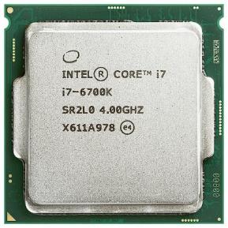
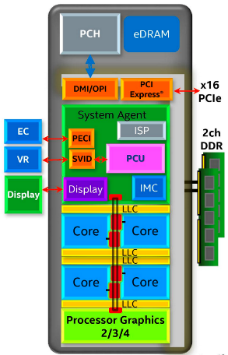
Chip-scale Features of 2015 x86 (Sky Lake)
Significant pieces:
Four OOO cores with deeper buffers
Intel MPX (Memory Protection Extensions)
Intel SGX (Software Guard Extensions)
Issue up to 6 μ-ops/cycle
GPU, System Agent (Mem, Fast I/O)
Large shared L3 cache with on-chip ring bus
2 MB/core instead of 1.5 MB/core
High-BW access to L3 Cache
Integrated I/O
Integrated memory controller (IMC)
Two independent channels of DRAM
High-speed PCI-Express (for Graphics cards)
Direct Media Interface (DMI) Connection to PCH (Platform Control Hub)
Notes:
Let’s look at I/O in a modern processor.

Slide 5
Sky Lake I/O: PCH
Platform Controller Hub
Connected to processor with proprietary bus
Direct Media Interface
Types of I/O on PCH:
USB, Ethernet
Thunderbolt 3
Audio, BIOS support
More PCI Express (lower speed than on Processor)
SATA (for Disks)
Sky Lake
System Configuration

Slide 6
Operational Parameters for I/O
Data granularity: Byte vs. Block
Some devices provide single byte at a time (e.g., keyboard)
Others provide whole blocks (e.g., disks, networks, etc.)
Access pattern: Sequential vs. Random
Some devices must be accessed sequentially (e.g., tape)
Others can be accessed “randomly” (e.g., disk, cd, etc.)
Fixed overhead to start transfers
Some devices require continual monitoring
Others generate interrupts when they need service
Transfer Mechanism: Programmed IO and DMA

Slide 7
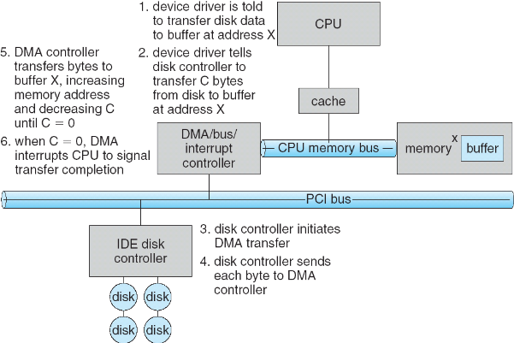
Transferring Data To/From Controller
Programmed I/O:
Each byte transferred via processor in/out or load/store
Pro: Simple hardware, easy to program
Con: Consumes processor cycles proportional to data size
Direct Memory Access:
Give controller access to memory bus
Ask it to transfer data blocks to/from memory directly
Sample interaction with DMA controller (from OSC book):
1
2
3

Slide 8
Transferring Data To/From Controller
Programmed I/O:
Each byte transferred via processor in/out or load/store
Pro: Simple hardware, easy to program
Con: Consumes processor cycles proportional to data size
Direct Memory Access:
Give controller access to memory bus
Ask it to transfer data blocks to/from memory directly
Sample interaction with DMA controller (from OSC book):
6
5
4

Slide 9
I/O Device Notifying the OS
The OS needs to know when:
The I/O device has completed an operation
The I/O operation has encountered an error
I/O Interrupt:
Device generates an interrupt whenever it needs service
Pro: handles unpredictable events well
Con: interrupts relatively high overhead
Polling:
OS periodically checks a device-specific status register
I/O device puts completion information in status register
Pro: low overhead
Con: may waste many cycles on polling if infrequent or unpredictable I/O operations
Actual devices combine both polling and interrupts
For instance – High-bandwidth network adapter:
Interrupt for first incoming packet
Poll for following packets until hardware queues are empty
Notes:
After the OS has issued a command to the I/O device either via a special I/O instruction or by writing to a location in the I/O address space, the OS needs to be notified when:
(a) The I/O device has completed the operation.
(b) Or when the I/O device has encountered an error.
This can be accomplished in two different ways: Polling and I/O interrupt.
+1 = 58 min. (Y:38)

Slide 10

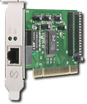
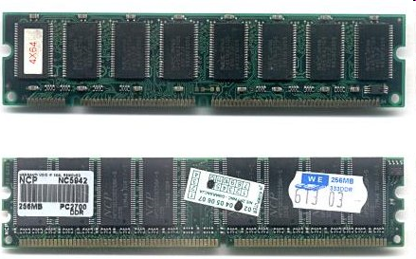
Kernel Device Structure
The System Call Interface
Process
Management
Memory Management
Filesystems
Device Control
Networking
Concurrency, multitasking
Virtual memory
Files and dirs: the VFS
TTYs and device access
Connectivity
Architecture
Dependent
Code
Memory Manager
File System Types
Device Control
Network Subsystem
Block Devices
IF drivers

Slide 11
Recall: Device Drivers
Device Driver: Device-specific code in the kernel that interacts directly with the device hardware
Supports a standard, internal interface
Same kernel I/O system can interact easily with different device drivers
Special device-specific configuration supported with the ioctl() system call
Device Drivers typically divided into two pieces:
Top half: accessed in call path from system calls
implements a set of standard, cross-device calls like open(), close(), read(), write(), ioctl(), strategy()
This is the kernel’s interface to the device driver
Top half will start I/O to device, may put thread to sleep until finished
Bottom half: run as interrupt routine
Gets input or transfers next block of output
May wake sleeping threads if I/O now complete

Slide 12
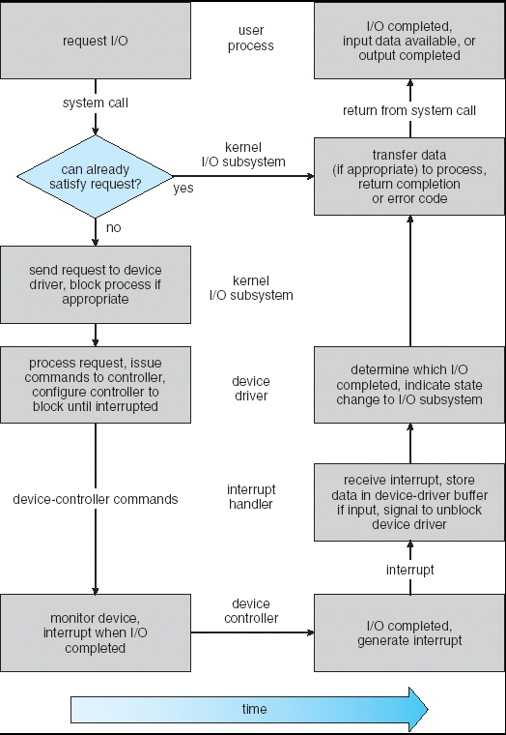
Recall: Life Cycle of An I/O Request
User
Program
Kernel I/O
Subsystem
Device Driver
Top Half
Device Driver
Bottom Half
Device
Hardware

Slide 13
The Goal of the I/O Subsystem
Provide Uniform Interfaces, Despite Wide Range of Different Devices
This code works on many different devices:
FILE fd = fopen("/dev/something", "rw"); for (int i = 0; i < 10; i++) { fprintf(fd, "Count %d\n", i); } close(fd);
Why? Because code that controls devices (“device driver”) implements standard interface
We will try to get a flavor for what is involved in actually controlling devices in rest of lecture
Can only scratch surface!

Slide 14
Want Standard Interfaces to Devices
Block Devices: e.g. disk drives, tape drives, DVD-ROM
Access blocks of data
Commands include open(), read(), write(), seek()
Raw I/O or file-system access
Memory-mapped file access possible
Character Devices: e.g. keyboards, mice, serial ports, some USB devices
Single characters at a time
Commands include get(), put()
Libraries layered on top allow line editing
Network Devices: e.g. Ethernet, Wireless, Bluetooth
Different enough from block/character to have own interface
Unix and Windows include socket interface
Separates network protocol from network operation
Includes select() functionality
Usage: pipes, FIFOs, streams, queues, mailboxes

Slide 15
How Does User Deal with Timing?
Blocking Interface: “Wait”
When request data (e.g. read() system call), put process to sleep until data is ready
When write data (e.g. write() system call), put process to sleep until device is ready for data
Non-blocking Interface: “Don’t Wait”
Returns quickly from read or write request with count of bytes successfully transferred
Read may return nothing, write may write nothing
Asynchronous Interface: “Tell Me Later”
When request data, take pointer to user’s buffer, return immediately; later kernel fills buffer and notifies user
When send data, take pointer to user’s buffer, return immediately; later kernel takes data and notifies user

Slide 16
Storage Devices
Magnetic disks
Storage that rarely becomes corrupted
Large capacity at low cost
Block level random access (except for SMR – later!)
Slow performance for random access
Better performance for sequential access
Flash memory
Storage that rarely becomes corrupted
Capacity at intermediate cost (5-20x disk)
Block level random access
Good performance for reads; worse for random writes
Erasure requirement in large blocks
Wear patterns issue

Slide 17
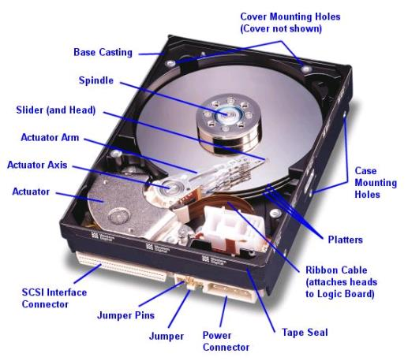
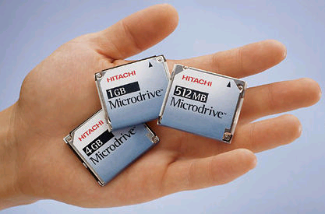
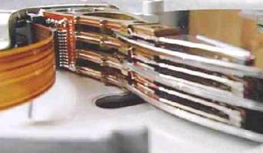
Hard Disk Drives (HDDs)
Read/Write Head
Side View
IBM/Hitachi Microdrive
IBM Personal Computer/AT (1986)
30 MB hard disk - $500
30-40ms seek time
0.7-1 MB/s (est.)
Western Digital Drive
http://www.storagereview.com/guide/

Slide 18
The Amazing Magnetic Disk
Unit of Transfer: Sector
Ring of sectors form a track
Stack of tracks form a cylinder
Heads position on cylinders
Disk Tracks ~ 1µm (micron) wide
Wavelength of light is ~ 0.5µm
Resolution of human eye: 50µm
100K tracks on a typical 2.5” disk
Separated by unused guard regions
Reduces likelihood neighboring tracks are corrupted during writes (still a small non-zero chance)

Slide 19
The Amazing Magnetic Disk
Track length varies across disk
Outside: More sectors per track, higher bandwidth
Disk is organized into regions of tracks with same # of sectors/track
Only outer half of radius is used
Most of the disk area in the outer regions of the disk
Disks so big that some companies (like Google) reportedly only use part of disk for active data
Rest is archival data

Slide 20
Shingled Magnetic Recording (SMR)
Overlapping tracks yields greater density, capacity
Restrictions on writing, complex DSP for reading

Slide 21
Review: Magnetic Disks
Track
Sector
Cylinders: all the tracks under the head at a given point on all surfaces
Read/write data is a three-stage process:
Seek time: position the head/arm over the proper track
Rotational latency: wait for desired sector to rotate under r/w head
Transfer time: transfer a block of bits (sector) under r/w head
Head
Cylinder
Platter
Disk Latency = Queueing Time + Controller time +
Seek Time + Rotation Time + Xfer Time
Software
Queue
(Device Driver)
Hardware
Controller
Media Time
(Seek+Rot+Xfer)
Request
Result

Slide 22
Typical Numbers for Magnetic Disk
Parameter | Info/Range
Space/Density | Space: 18TB (Seagate), 9 platters, in 3½ inch form factor! Areal Density: ≥ 1 Terabit/square inch! (PMR, Helium, …)
Average Seek Time | Typically 4-6 milliseconds
Average Rotational Latency | Most laptop/desktop disks rotate at 3600-7200 RPM (16-8 ms/rotation). Server disks up to 15,000 RPM. Average latency is halfway around disk so 4-8 milliseconds
Controller Time | Depends on controller hardware
Transfer Time | Typically 50 to 270 MB/s. Depends on: Transfer size (usually a sector): 512B – 1KB per sector Rotation speed: 3600 RPM to 15000 RPM Recording density: bits per inch on a track Diameter: ranges from 1 in to 5.25 in
Cost | Used to drop by a factor of two every 1.5 years (or faster), now slowing down

Slide 23
Disk Performance Example
Assumptions:
Ignoring queuing and controller times for now
Avg seek time of 5ms,
7200RPM ⇒ Time for rotation: 60000 (ms/min) / 7200(rev/min) ~= 8ms
Transfer rate of 50MByte/s, block size of 4Kbyte ⇒ 4096 bytes/50×10⁶ (bytes/s) = 81.92 × 10⁻⁶ sec ≅ 0.082 ms for 1 sector
Read block from random place on disk:
Seek (5ms) + Rot. Delay (4ms) + Transfer (0.082ms) = 9.082ms
Approx 9ms to fetch/put data: 4096 bytes/9.082×10⁻³ s ≅ 451KB/s
Read block from random place in same cylinder:
Rot. Delay (4ms) + Transfer (0.082ms) = 4.082ms
Approx 4ms to fetch/put data: 4096 bytes/4.082×10⁻³ s ≅ 1.03MB/s
Read next block on same track:
Transfer (0.082ms): 4096 bytes/0.082×10⁻³ s ≅ 50MB/sec
Key to using disk effectively (especially for file systems) is to minimize seek and rotational delays

Slide 24
Lots of Intelligence in the Controller
Sectors contain sophisticated error correcting codes
Disk head magnet has a field wider than track
Hide corruptions due to neighboring track writes
Sector sparing
Remap bad sectors transparently to spare sectors on the same surface
Slip sparing
Remap all sectors (when there is a bad sector) to preserve sequential behavior
Track skewing
Sector numbers offset from one track to the next, to allow for disk head movement for sequential ops

Slide 25
Hard Drive Prices over Time

Slide 26
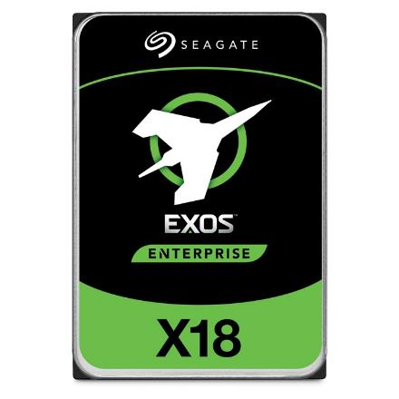
Example of Current HDDs
Seagate Exos X18 (2020)
18 TB hard disk
9 platters, 18 heads
Helium filled: reduce friction and power
4.16ms average seek time
4096 byte physical sectors
7200 RPMs
Dual 6 Gbps SATA /12Gbps SAS interface
270MB/s MAX transfer rate
Cache size: 256MB
Price: $ 562 (~ $0.03/GB)
IBM Personal Computer/AT (1986)
30 MB hard disk
30-40ms seek time
0.7-1 MB/s (est.)
Price: $500 ($17K/GB, 340,000x more expensive !!)

Slide 27
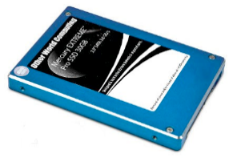
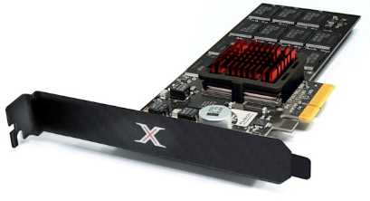
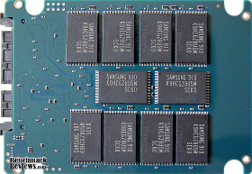
Solid State Disks (SSDs)
1995 – Replace rotating magnetic media with non-volatile memory (battery backed DRAM)
2009 – Use NAND Multi-Level Cell (2 or 3-bit/cell) flash memory
Sector (4 KB page) addressable, but stores 4-64 “pages” per memory block
Trapped electrons distinguish between 1 and 0
No moving parts (no rotate/seek motors)
Eliminates seek and rotational delay (0.1-0.2ms access time)
Very low power and lightweight
Limited “write cycles”
Rapid advances in capacity and cost ever since!

Slide 28
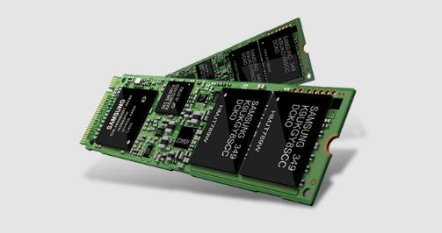
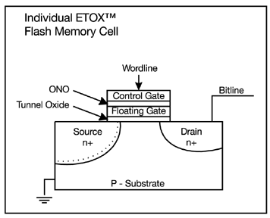
FLASH Memory
Samsung 2015:
512GB, NAND Flash
Like a normal transistor but:
Has a floating gate that can hold charge
To write: raise or lower wordline high enough to cause charges to tunnel
To read: turn on wordline as if normal transistor
presence of charge changes threshold and thus measured current
Two varieties:
NAND: denser, must be read and written in blocks
NOR: much less dense, fast to read and write
V-NAND: 3D stacking (Samsung claims 1TB possible in 1 chip)

Slide 29
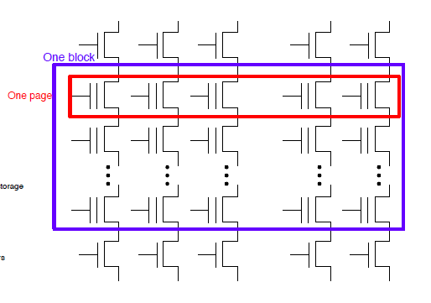
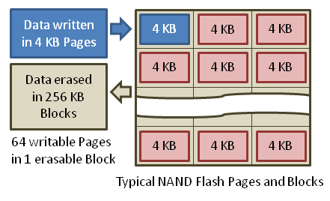
Flash Memory (Con’t)
Data read and written in page-sized chunks (e.g. 4K)
Cannot be addressed at byte level
Random access at block level for reads (no locality advantage)
Writing of new blocks handled in order (kinda like a log)
Before writing, must be erased (256K block at a time)
Requires free-list management
CANNOT write over existing block (Copy-on-Write is normal case)

Slide 30
SSD Architecture – Reads
NAND
NAND
NAND
NAND
NAND
NAND
NAND
NAND
Host
Buffer
Manager
(software
Queue)
Flash
Memory
Controller
NAND
NAND
NAND
NAND
SATA
NAND
NAND
NAND
NAND
NAND
NAND
NAND
NAND
DRAM
NAND
NAND
Read 4 KB Page: ~25 usec
No seek or rotational latency
Transfer time: transfer a 4KB page
SATA: 300-600MB/s => ~4 x10³ b / 400 x 10⁶ bps => 10 us
Latency = Queuing Time + Controller time + Xfer Time
Highest Bandwidth: Sequential OR Random reads
NAND
NAND
NAND
NAND
NAND
NAND
NAND
NAND
NAND
NAND

Slide 31
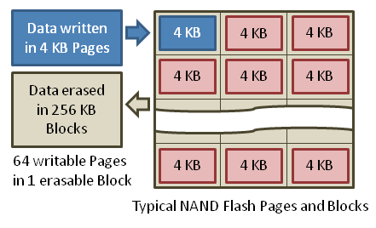
SSD Architecture – Writes
Writing data is complex! (~200μs – 1.7ms)
Can only write empty pages in a block
Erasing a block takes ~1.5ms
Controller maintains pool of empty blocks by coalescing used pages (read, erase, write), also reserves some % of capacity
Rule of thumb: writes 10x reads, erasure 10x writes
https://en.wikipedia.org/wiki/Solid-state_drive

Slide 32
SSD Architecture – Writes
SSDs provide same interface as HDDs to OS – read and write chunk (4KB) at a time
But can only overwrite data 256KB at a time!
Why not just erase and rewrite new version of entire 256KB block?
Erasure is very slow (milliseconds)
Each block has a finite lifetime, can only be erased and rewritten about 10K times
Heavily used blocks likely to wear out quickly

Slide 33
Solution – Two Systems Principles
Layer of Indirection
Maintain a Flash Translation Layer (FTL) in SSD
Map virtual block numbers (which OS uses) to physical page numbers (which flash mem. controller uses)
Can now freely relocate data w/o OS knowing
Copy on Write
Don’t overwrite a page when OS updates its data
Instead, write new version in a free page
Update FTL mapping to point to new location

Slide 34
Flash Translation Layer
No need to erase and rewrite entire 256KB block when making small modifications
SSD controller can assign mappings to spread workload across pages
Wear Levelling
What to do with old versions of pages?
Garbage Collection in background
Erase blocks with old pages, add to free list

Slide 35
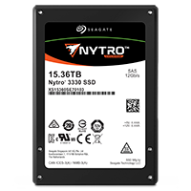
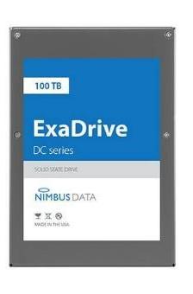
Some “Current” (large) 3.5in SSDs
Seagate Exos SSD: 15.36TB (2017)
Dual 12Gb/s interface
Seq reads 860MB/s
Seq writes 920MB/s
Random Reads (IOPS): 102K
Random Writes (IOPS): 15K
Price (Amazon): $5495 ($0.36/GB)
Nimbus SSD: 100TB (2019)
Dual port: 12Gb/s interface
Seq reads/writes: 500MB/s
Random Read Ops (IOPS): 100K
Unlimited writes for 5 years!
Price: ~ $40K? ($0.4/GB)
However, 50TB drive costs $12500 ($0.25/GB)

Slide 36
SSD Summary
Pros (vs. hard disk drives):
Low latency, high throughput (eliminate seek/rotational delay)
No moving parts:
Very light weight, low power, silent, very shock insensitive
Read at memory speeds (limited by controller and I/O bus)
Cons
Small storage (0.1-0.5x disk), expensive (3-20x disk)
Hybrid alternative: combine small SSD with large HDD

Slide 37
SSD Summary
Pros (vs. hard disk drives):
Low latency, high throughput (eliminate seek/rotational delay)
No moving parts:
Very light weight, low power, silent, very shock insensitive
Read at memory speeds (limited by controller and I/O bus)
Cons
Small storage (0.1-0.5x disk), expensive (3-20x disk)
Hybrid alternative: combine small SSD with large HDD
Asymmetric block write performance: read pg/erase/write pg
Controller garbage collection (GC) algorithms have major effect on performance
Limited drive lifetime
1-10K writes/page for MLC NAND
Avg failure rate is 6 years, life expectancy is 9–11 years
These are changing rapidly!
No longer true!

Slide 38
Ways of Measuring Performance: Times (s) and Rates (op/s)
Latency – time to complete a task
Measured in units of time (s, ms, us, …, hours, years)
Response Time - time to initiate and operation and get its response
Able to issue one that depends on the result
Know that it is done (anti-dependence, resource usage)
Throughput or Bandwidth – rate at which tasks are performed
Measured in units of things per unit time (ops/s, GFLOP/s)
Start up or “Overhead” – time to initiate an operation
Most I/O operations are roughly linear in b bytes
Latency(b) = Overhead + b/TransferCapacity
Performance???
Operation time (4 mins to run a mile…)
Rate (mph, mpg, …)

Slide 39
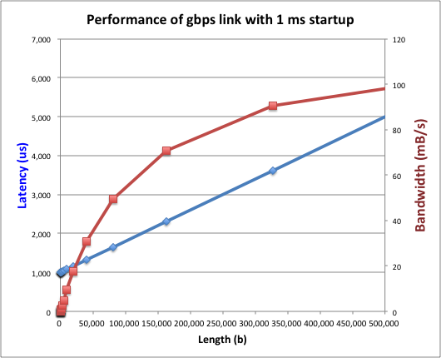
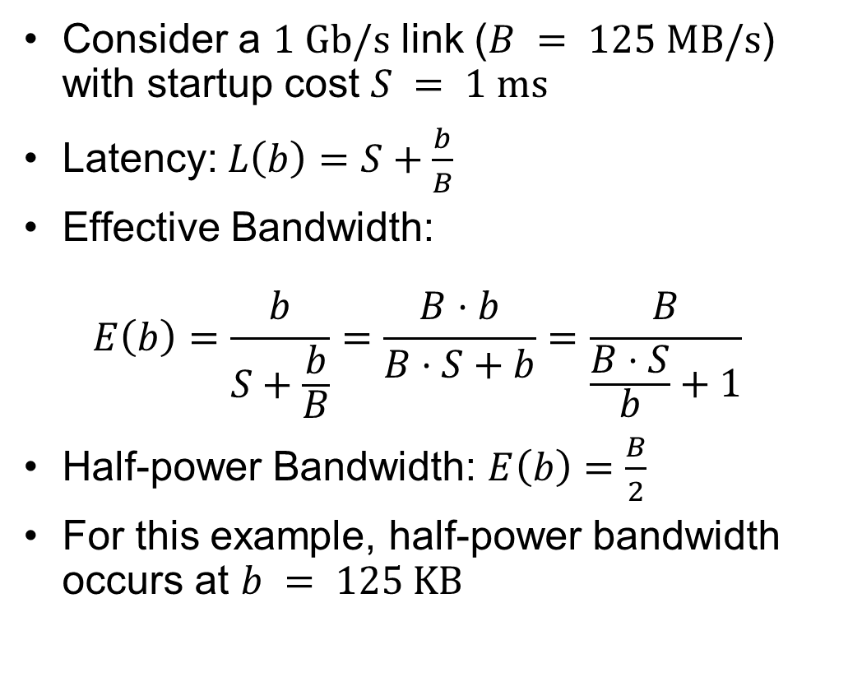
Example: Overhead in Fast Network
Consider a $1 \text{Gb}\text{/}\text{s}$ link ($B = 125 \text{MB}\text{/}\text{s}$) with startup cost $S = 1 \text{ms}$
Latency:$L\left(b\right)=S+\frac{b}{B}$
Effective Bandwidth: $E\left(b\right)=\frac{b}{S+\frac{b}{B}}=\frac{B⋅b}{B⋅S+b}=\frac{B}{\frac{B⋅S}{b}+1}$
Half-power Bandwidth: $E\left(b\right)=\frac{B}{2}$
For this example, half-power bandwidth occurs at $b = 125 \text{KB}$

Slide 40
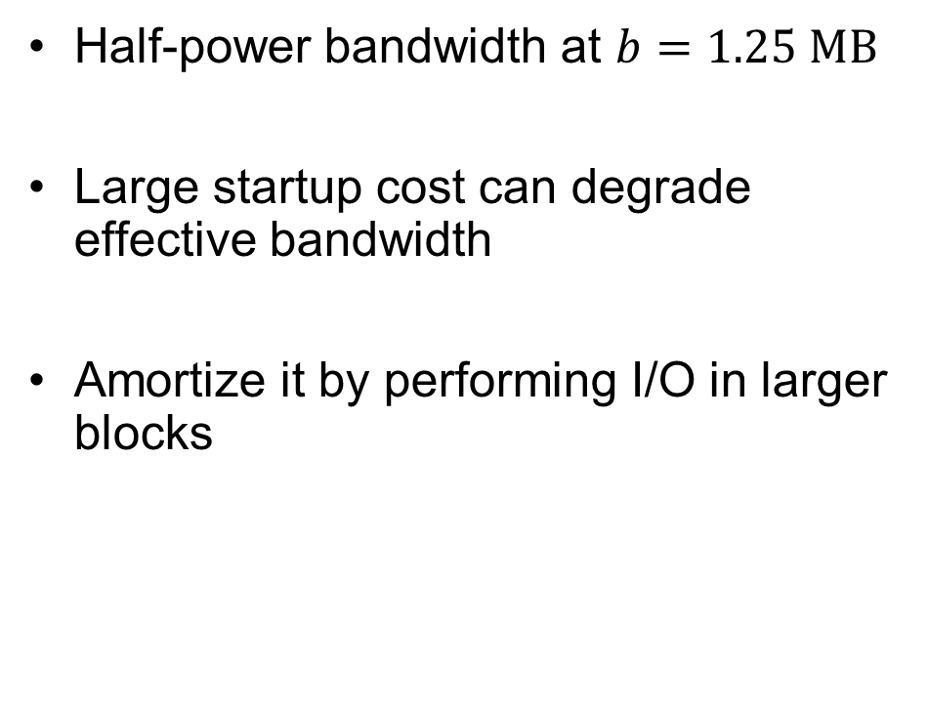
Example: 10 ms Startup Cost (e.g., Disk)
Half-power bandwidth at $b=1.25 \text{MB}$
Large startup cost can degrade effective bandwidth
Amortize it by performing I/O in larger blocks
Half-power b = 1,250,000 bytes!

Slide 41
What Determines Peak BW for I/O?
Bus Speed
PCI-X: 1064 MB/s = 133 MHz x 64 bit (per lane)
ULTRA WIDE SCSI: 40 MB/s
Serial Attached SCSI & Serial ATA & IEEE 1394 (firewire): 1.6 Gb/s full duplex (200 MB/s)
USB 3.0 – 5 Gb/s
Thunderbolt 3 – 40 Gb/s
Device Transfer Bandwidth
Rotational speed of disk
Write / Read rate of NAND flash
Signaling rate of network link
Whatever is the bottleneck in the path…

Slide 42
Overall Performance for I/O Path
Controller
Performance of I/O subsystem
Metrics: Response Time, Throughput
Effective BW = transfer size / response time
Contributing factors to latency:
Software paths (can be loosely modeled by a queue)
Hardware controller
I/O device service time
Queuing behavior:
Can lead to big increases of latency as utilization increases
Solutions?
User
Thread
I/O
device
Queue
[OS Paths]
Response Time = Queue + I/O device service time
300
Response
Time (ms)
200
100
0
0%
100%
Throughput (Utilization)
(% total BW)

Slide 43
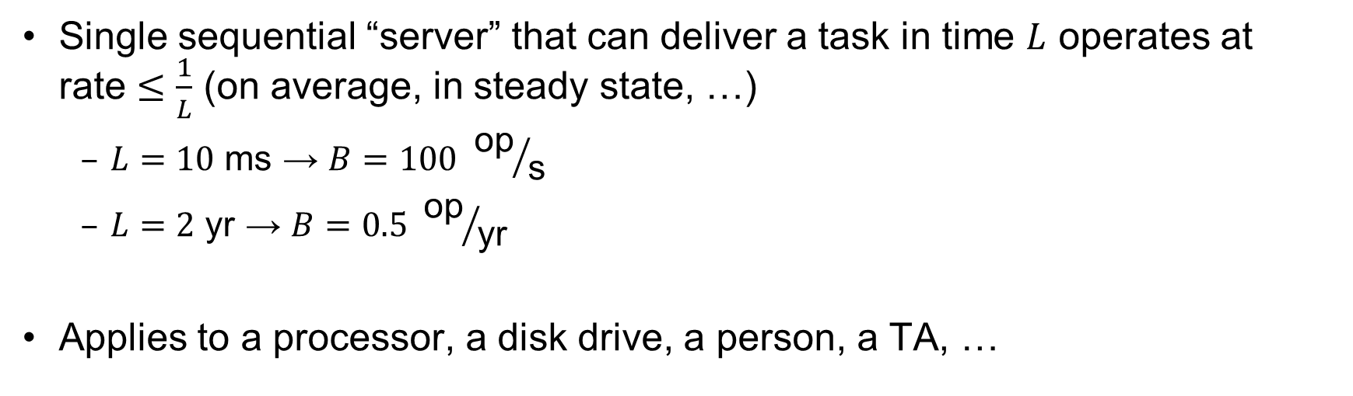
Sequential Server Performance
L
L
L
L
…
L
time
Single sequential “server” that can deliver a task in time $L$ operates at rate $≤\frac{1}{L}$ (on average, in steady state, …)
$L=10 \text{ms}$ → $B=100 {\text{op}}/{\text{s}}$
$L=2 \text{yr}$ → $B=0.5 {\text{op}}/{\text{yr}}$
Applies to a processor, a disk drive, a person, a TA, …

Slide 44
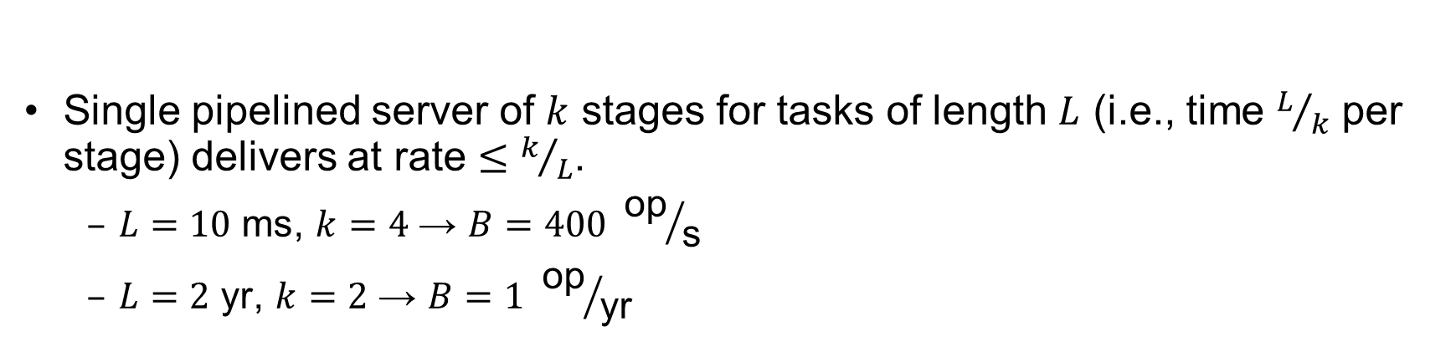
Single Pipelined Server
L
L
divided over distinct resources
logical operation
L
L
L
L
L
L
L
…
time
Single pipelined server of $k$ stages for tasks of length $L$ (i.e., time $L/k$ per stage) delivers at rate $≤k/L$.
$L=10 \text{ms}$, $k=4$ → $B=400 {\text{op}}/{\text{s}}$
$L=2 \text{yr}$, $k=2$ → $B=1 {\text{op}}/{\text{yr}}$

Slide 45
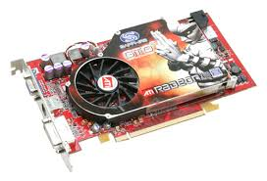

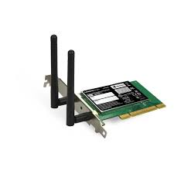
Example Systems “Pipelines”
I/O Processing
File
System
Upper Driver
Lower Driver
User Process
syscall
Communication
Anything with queues between operational process behaves roughly “pipeline like”
Important difference is that “initiations” are decoupled from processing
May have to queue up a burst of operations
Not synchronous and deterministic like in 61C

Slide 46
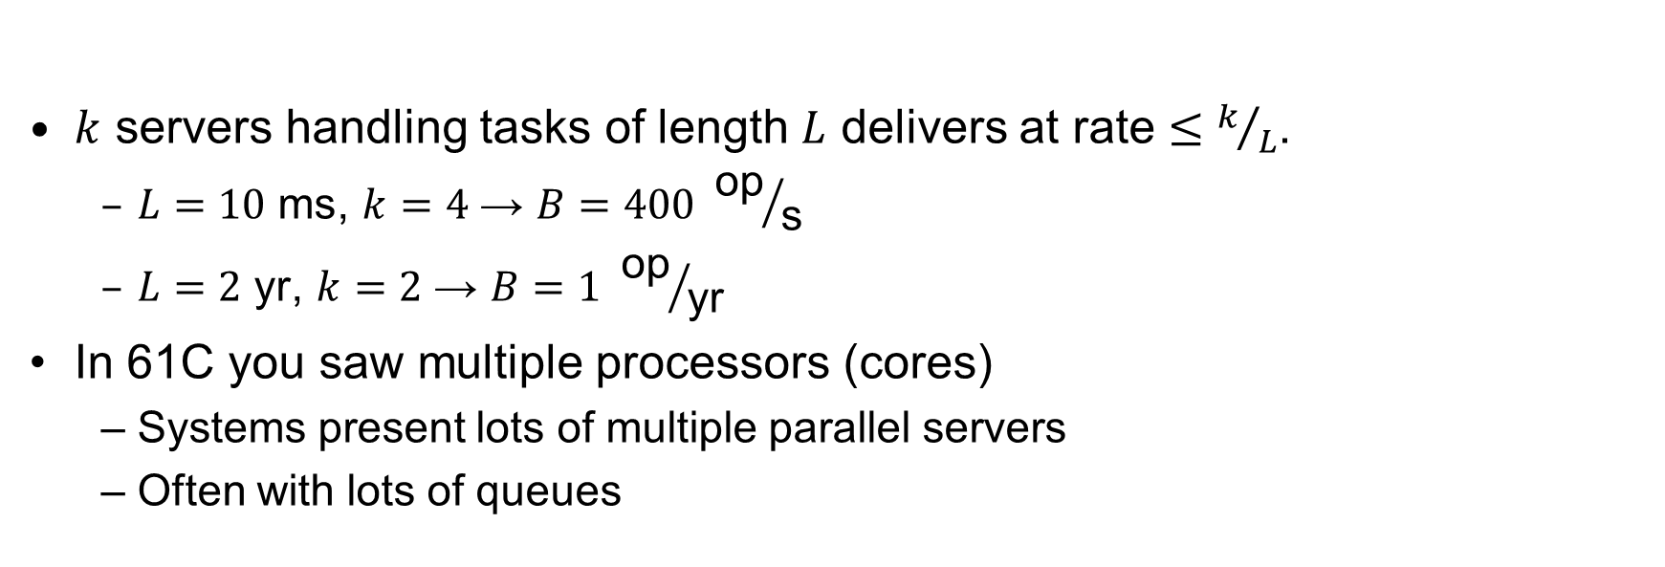
Multiple Servers
L
…
k
$k$ servers handling tasks of length $L$ delivers at rate $≤k/L$.
$L=10 \text{ms}$, $k=4$ → $B=400 {\text{op}}/{\text{s}}$
$L=2 \text{yr}$, $k=2$ → $B=1 {\text{op}}/{\text{yr}}$
In 61C you saw multiple processors (cores)
Systems present lots of multiple parallel servers
Often with lots of queues

Slide 47

Example Systems “Parallelism”
I/O Processing
syscall
File
System
Upper Driver
Lower Driver
User Process
User Process
User Process
Communication
Parallel Computation, Databases, …

Slide 48
Conclusion (1/2)
Notification mechanisms
Interrupts
Polling: Report results through status register that processor looks at periodically
Device drivers interface to I/O devices
Provide clean Read/Write interface to OS above
Manipulate devices through PIO, DMA & interrupt handling
Three types: block, character, and network
Direct Memory Access (DMA)
Permit devices to directly access memory
Free up processor from transferring every byte

Slide 49
Conclusion (2/2)
Disk Performance:
Queuing time + Controller + Seek + Rotational + Transfer
Rotational latency: on average ½ rotation
Transfer time: spec of disk depends on rotation speed and bit storage density
Devices have complex interaction and performance characteristics
Response time (Latency) = Queue + Overhead + Transfer
Effective BW = BW * T/(S+T)
HDD: Queuing time + controller + seek + rotation + transfer
SSD: Queuing time + controller + transfer (erasure & wear)
Systems (e.g., file system) designed to optimize performance and reliability
Relative to performance characteristics of underlying device
Next time: Bursts & High Utilization introduce queuing delays
Next time: Queuing Latency:
M/M/1 and M/G/1 queues: simplest to analyze
As utilization approaches 100%, latency → ∞
T_{q} = T_{ser} x ½(1+C) x ρ/(1 – ρ))

